Slide 1


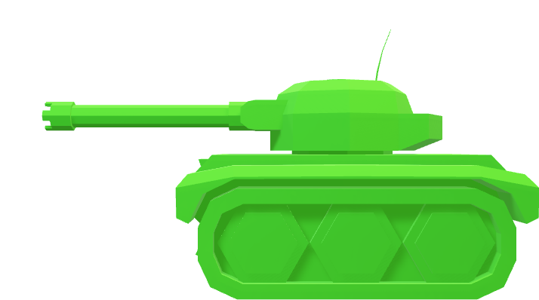


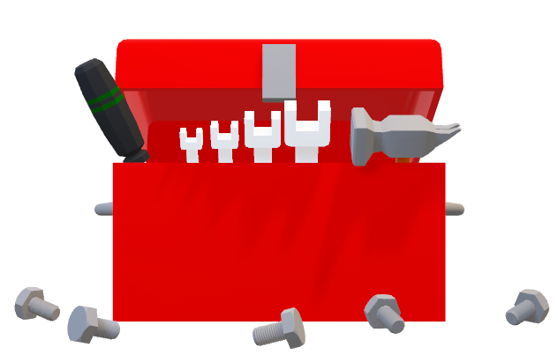

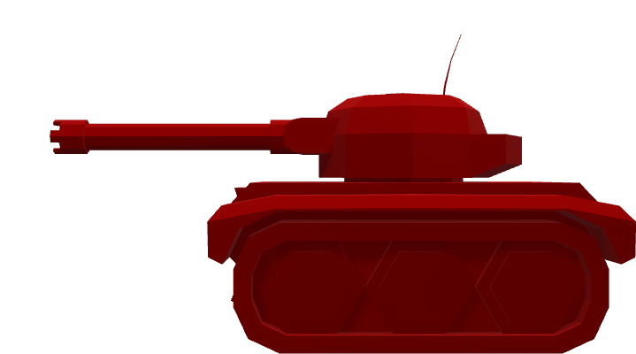

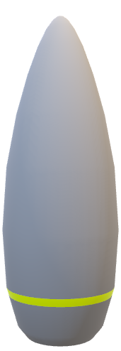
Title
Text
Press Space To Begin
Presentation
Group 20
Smart Tank

Slide 2
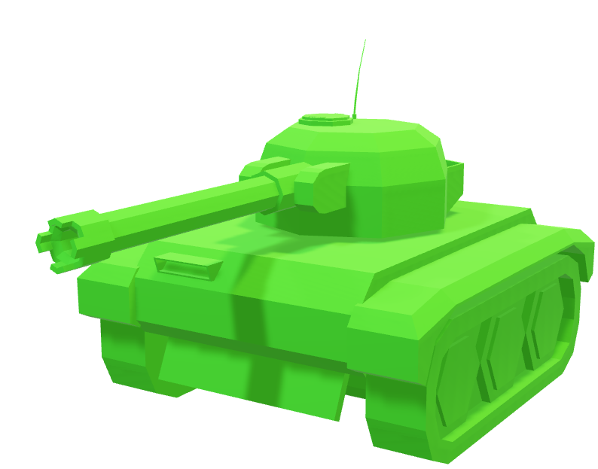
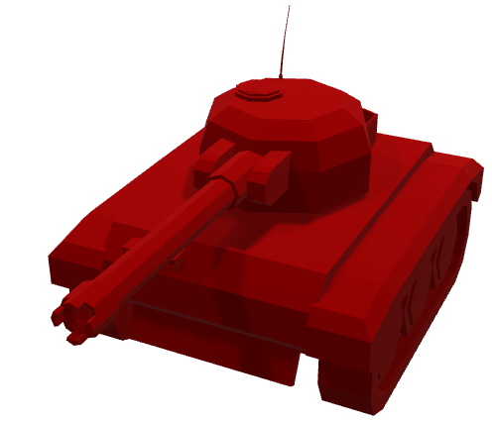
Group 20
Smart Tank
(With Animations)

Slide 3
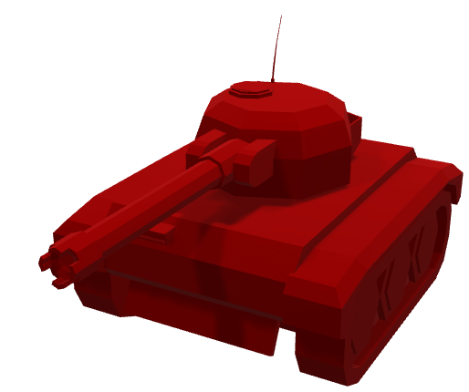
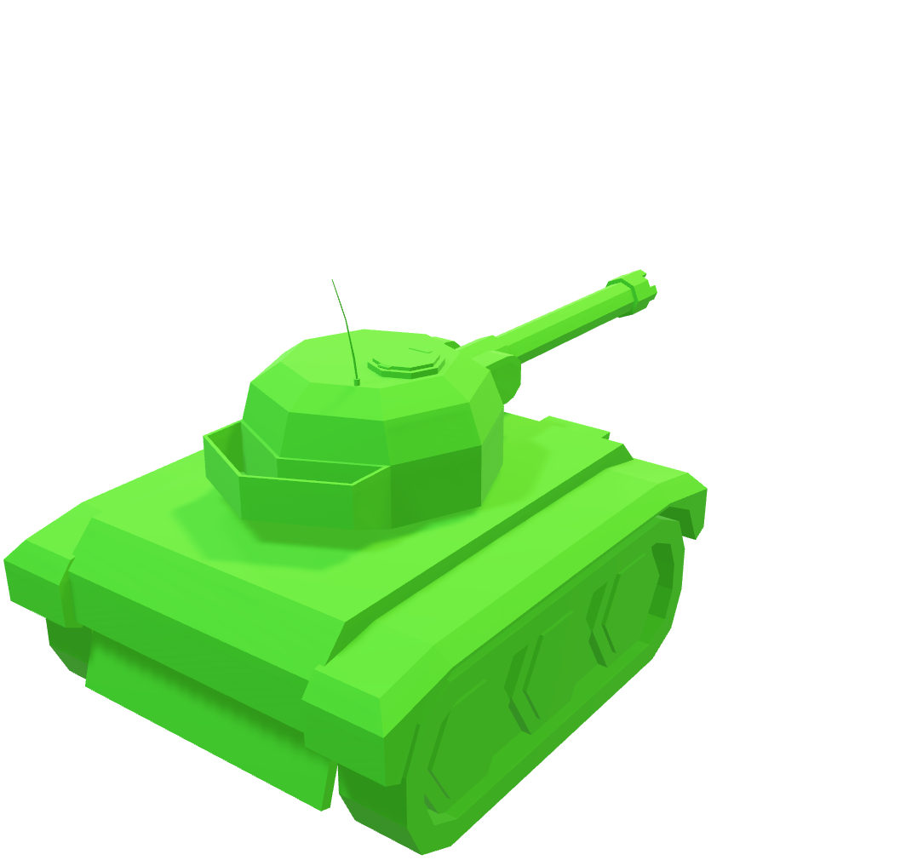
Group 20
Smart Tank
(With Animations)

Slide 4
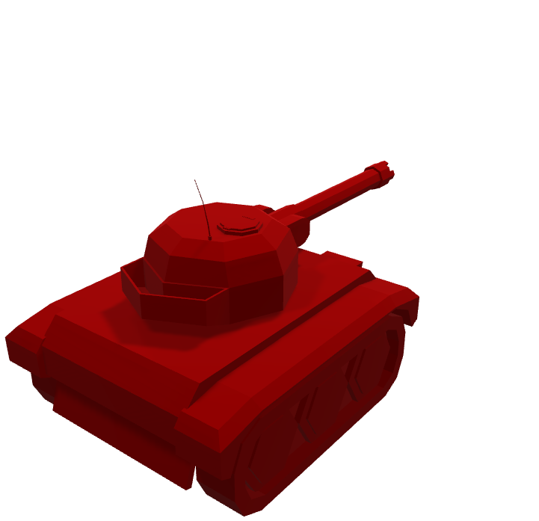
Group 20
Smart Tank
(With Animations)
Made By:
Lunar
Dylan
Dimitrios

Slide 5
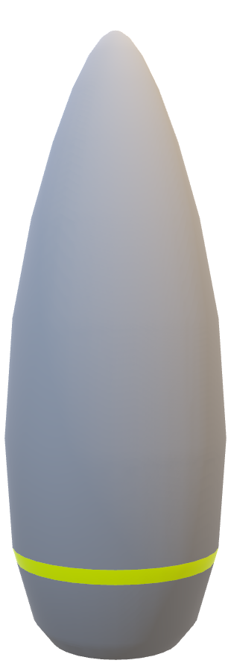
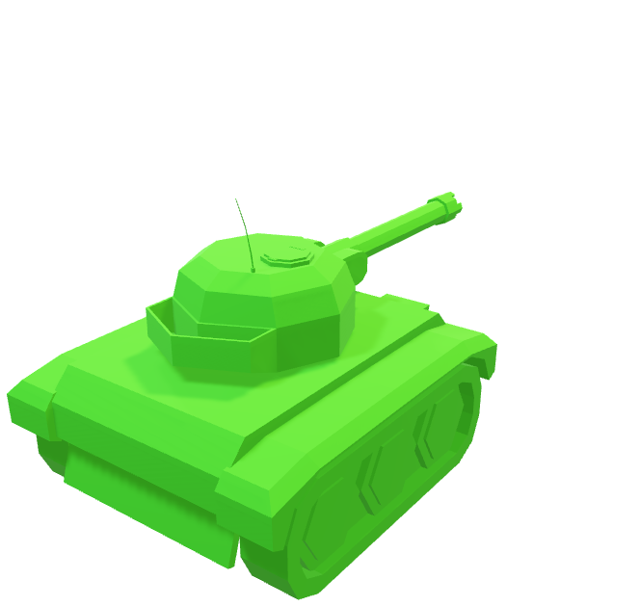
Our State Machine
A Brief Introduction
Made By:
Lunar
Dylan
Dimitrios (Jim)
Our Tank’s State Machine makes use of these States:
Initial State
Attack State
Searching State
Of which are controlled by a Finite State Machine.

Slide 6
Our State Machine
A Brief Introduction
Made By:
Lunar
Dylan
Dimitrios (Jim)
Our Tank uses a rule based finite state machine. It selects one of several states based on a set of rules. These states include:
Rush State
Enemy Attack State
Patrol State
Collect State
Base Attack State
Base Defense State

Slide 7

Our State Machine
A Brief Introduction
Made By:
Lunar
Dylan
Dimitrios
Our Tank uses a rule based finite state machine. It selects one of several states based on a set of rules. These states include:
Rush State
Enemy Attack State
Patrol State
Collect State
Base Attack State
Base Defense State

Slide 8

Our State Machine
A Brief Introduction
Our Tank uses a rule based finite state machine. It selects one of several states based on a set of rules. These states include:
Rush State
Enemy Attack State
Patrol State
Collect State
Base Attack State
Base Defense State
Rush State
Made By:
Lunar
Dylan
Dimitrios
The Rush state is the initial state of the tank, in this state the tank will navigate to the opposite end of the map The tank will enter this state on-start
The tank will leave this state if a point of interest is found.

Slide 9
Our State Machine
A Brief Introduction
Our Tank uses a rule based finite state machine. It selects one of several states based on a set of rules. These states include:
Rush State
Enemy Attack State
Patrol State
Collect State
Base Attack State
Base Defense State
Rush State
Made By:
Lunar
Dylan
Dimitrios
The Rush state is the initial state of the tank, in this state the tank will navigate to the opposite end of the map The tank will enter this state on-start
The tank will leave this state if a point of interest is found.

Slide 10


Rush State
The Rush state is the initial state of the tank, in this state the tank will navigate to the opposite end of the map The tank will enter this state on-start
The tank will leave this state if a point of interest is found.
Enemy Attack State
The Enemy Attack State is responsible for aggression against enemies.
During this state the tank will chase, circle and attack enemies.
The Tank will enter this state if an enemy is in view The Tank will leave this state if there is no enemy in view or if health, fuel or ammo is low

Slide 11
Rush State
Enemy Attack State
The Enemy Attack State is responsible for aggression against enemies.
During this state the tank will chase, circle and attack enemies.
The Tank will enter this state if an enemy is in view The Tank will leave this state if there is no enemy in view or if health, fuel or ammo is low
The Rush state is the initial state of the tank, in this state the tank will navigate to the opposite end of the map The tank will enter this state on-start
The tank will leave this state if a point of interest is found.

Slide 12
Rush State
Enemy Attack State
The Enemy Attack State is responsible for aggression against enemies.
During this state the tank will chase, circle and attack enemies.
The Tank will enter this state if an enemy is in view The Tank will leave this state if there is no enemy in view or if health, fuel or ammo is low
The Rush state is the initial state of the tank, in this state the tank will navigate to the opposite end of the map The tank will enter this state on-start
The tank will leave this state if a point of interest is found.

Slide 13

Rush State
Enemy Attack State
Patrol State
Collect State
The Enemy Attack State is responsible for aggression against enemies.
During this state the tank will chase, circle and attack enemies.
The Tank will enter this state if an enemy is in view The Tank will leave this state if there is no enemy in view or if health, fuel or ammo is low
The Patrol State is an Idle state where the tank will path to random points on the map searching for points of interest (collectables, enemies, bases) The tank will enter this state if there are no current targets The tank will leave this state when a target is found.
During the collect state the tank will path towards any collectibles detected to replenish supplies (health ammo and fuel)
The tank will enter this state when supplies are low and a collectible is found The tank will leave this state if there are no collectibles found or if supplies are no longer low.
The Rush state is the initial state of the tank, in this state the tank will navigate to the opposite end of the map The tank will enter this state on-start
The tank will leave this state if a point of interest is found.
Text

Slide 14
Patrol State
Rush State
Enemy Attack State
The Enemy Attack State is responsible for aggression against enemies.
During this state the tank will chase, circle and attack enemies.
The Tank will enter this state if an enemy is in view The Tank will leave this state if there is no enemy in view or if health, fuel or ammo is low
The Patrol State is an Idle state where the tank will path to random points on the map searching for points of interest (collectables, enemies, bases) The tank will enter this state if there are no current targets The tank will leave this state when a target is found.
The Rush state is the initial state of the tank, in this state the tank will navigate to the opposite end of the map The tank will enter this state on-start
The tank will leave this state if a point of interest is found.
Text

Slide 15



Collect State
During the collect state, the tank will path towards any collectibles detected to replenish supplies (health ammo and fuel)
The tank will enter this state when supplies are low, and a collectible is found The tank will leave this state if there are no collectibles found or if supplies are no longer low.
Patrol State
The Patrol State is an Idle state where the tank will path to random points on the map searching for points of interest (collectables, enemies, bases) The tank will enter this state if there are no current targets The tank will leave this state when a target is found.
Text

Slide 16
Patrol State
Collect State
The Patrol State is an Idle state where the tank will path to random points on the map searching for points of interest (collectables, enemies, bases) The tank will enter this state if there are no current targets The tank will leave this state when a target is found.
During the collect state, the tank will path towards any collectibles detected to replenish supplies (health ammo and fuel)
The tank will enter this state when supplies are low, and a collectible is found The tank will leave this state if there are no collectibles found or if supplies are no longer low.
Text

Slide 17
Patrol State
Collect State
The Patrol State is an Idle state where the tank will path to random points on the map searching for points of interest (collectables, enemies, bases) The tank will enter this state if there are no current targets The tank will leave this state when a target is found.
During the collect state, the tank will path towards any collectibles detected to replenish supplies (health ammo and fuel)
The tank will enter this state when supplies are low, and a collectible is found The tank will leave this state if there are no collectibles found or if supplies are no longer low.
Text

Slide 18
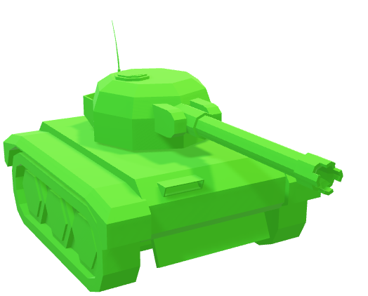
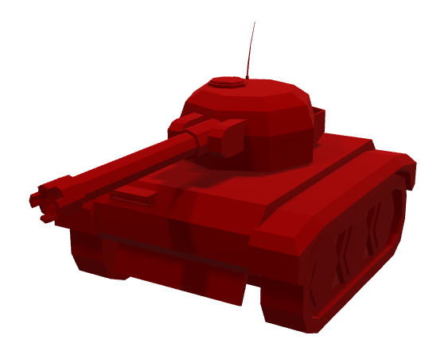
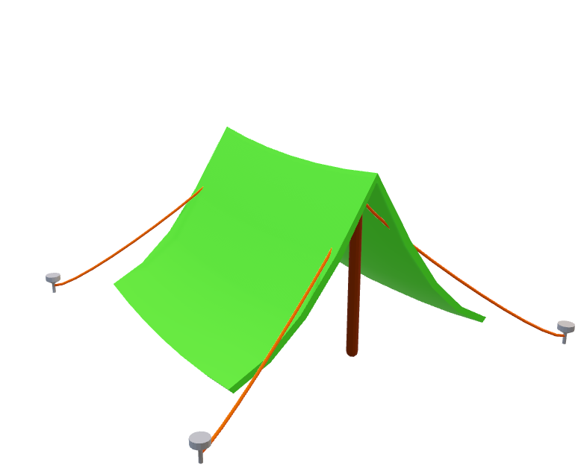

Base Attack State
During the Base attack state, the tank will path towards any nearby bases, shoot them, and retreat. The tank will enter this state when a base is detected* The tank will exit this state if no bases are detected
Patrol State
Collect State
The Patrol State is an Idle state where the tank will path to random points on the map searching for points of interest (collectables, enemies, bases) The tank will enter this state if there are no current targets The tank will leave this state when a target is found.
During the collect state, the tank will path towards any collectibles detected to replenish supplies (health ammo and fuel)
The tank will enter this state when supplies are low, and a collectible is found The tank will leave this state if there are no collectibles found or if supplies are no longer low.

Slide 19
Base Attack State
During the Base attack state, the tank will path towards any nearby bases, shoot them, and retreat. The tank will enter this state when a base is detected* The tank will exit this state if no bases are detected
Patrol State
Collect State
The Patrol State is an Idle state where the tank will path to random points on the map searching for points of interest (collectables, enemies, bases) The tank will enter this state if there are no current targets The tank will leave this state when a target is found.
During the collect state, the tank will path towards any collectibles detected to replenish supplies (health ammo and fuel)
The tank will enter this state when supplies are low, and a collectible is found The tank will leave this state if there are no collectibles found or if supplies are no longer low.

Slide 20
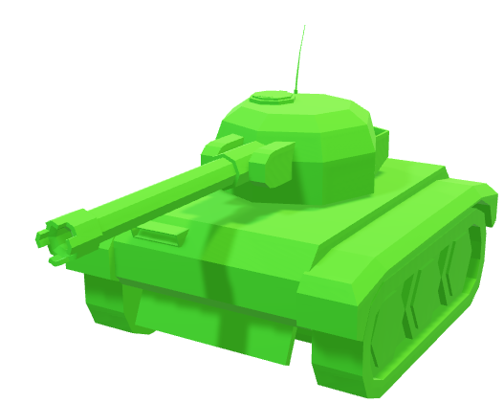

Base Defense State
During the Base Defense State, the tank will path towards its own base to protect it from the enemy attacker The tank will enter this state if a base is destroyed The tank will exit this state if the bases are no longer under attack
Base Attack State
During the Base attack state, the tank will path towards any nearby bases, shoot them, and retreat. The tank will enter this state when a base is detected* The tank will exit this state if no bases are detected

Slide 21
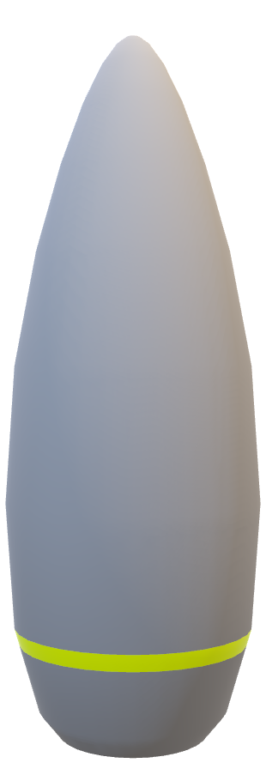
Base Attack State
Base Defense State
During the Base attack state, the tank will path towards any nearby bases, shoot them, and retreat. The tank will enter this state when a base is detected* The tank will exit this state if no bases are detected
During the Base Defense State, the tank will path towards its own base to protect it from the enemy attacker The tank will enter this state if a base is destroyed The tank will exit this state if the bases are no longer under attack

Slide 22
The Chase State
Base Attack State
Base Defense State
During the Chase State tank will move towards the targeted enemy. The tank will path towards the enemy in order to close the distance before attacking. The Tank will switch to this state when an enemy is spotted. The tank will exit this state when the enemy tank is in range.
During the Base attack state, the tank will path towards any nearby bases, shoot them, and retreat. The tank will enter this state when a base is detected* The tank will exit this state if no bases are detected
During the Base Defense State, the tank will path towards its own base to protect it from the enemy attacker The tank will enter this state if a base is destroyed The tank will exit this state if the bases are no longer under attack

Slide 23
What is a Finite State Machine?
A Finite State Machine is an AI that selects from a series of states based on various conditions. The FSM can switch states when a condition changes.
Each state contains a series of behaviors to be carried out. Our tank makes use of various states, each with different behaviors that are switched according to what is currently happening in the scene.
The Chase State
Base Attack State
Base Defense State
During the Chase State tank will move towards the targeted enemy. The tank will path towards the enemy in order to close the distance before attacking. The Tank will switch to this state when an enemy is spotted. The tank will exit this state when the enemy tank is in range.
During the Base attack state, the tank will path towards any nearby bases, shoot them, and retreat. The tank will enter this state when a base is detected* The tank will exit this state if no bases are detected
During the Base Defense State, the tank will path towards its own base to protect it from the enemy attacker The tank will enter this state if a base is destroyed The tank will exit this state if the bases are no longer under attack

Slide 24
What is a Finite State Machine?
What is a Rule Based System?
Base Attack State
Base Defense State
A Finite State Machine is an AI that selects from a series of states based on various conditions. The FSM can switch states when a condition changes.
Each state contains a series of behaviors to be carried out. Our tank makes use of various states, each with different behaviors that are switched according to what is currently happening in the scene.
A Rule Based System is a system that relies on various facts called Predicates to make decisions.
Predicates represent Boolean Truths (True/False)
We can use these Predicates to construct Rules, and the outcome of the decision will rely on whether rules are met. Rule based systems are known as a Goal Driven Architecture for AI, meaning the AI has a final goal (such as destroying the enemy tank.)
During the Base attack state, the tank will path towards any nearby bases, shoot them, and retreat. The tank will enter this state when a base is detected* The tank will exit this state if no bases are detected
During the Base Defense State, the tank will path towards its own base to protect it from the enemy attacker The tank will enter this state if a base is destroyed The tank will exit this state if the bases are no longer under attack
The Chase State
During the Chase State tank will move towards the targeted enemy. The tank will path towards the enemy in order to close the distance before attacking. The Tank will switch to this state when an enemy is spotted. The tank will exit this state when the enemy tank is in range.

Slide 25
What is a Finite State Machine?
What is a Rule Based System?
A Finite State Machine is an AI that selects from a series of states based on various conditions. The FSM can switch states when a condition changes.
Each state contains a series of behaviors to be carried out. Our tank makes use of various states, each with different behaviors that are switched according to what is currently happening in the scene.
A Rule Based System is a system that relies on various facts called Predicates to make decisions.
Predicates represent Boolean Truths (True/False)
We can use these Predicates to construct Rules, and the outcome of the decision will rely on whether rules are met. Rule based systems are known as a Goal Driven Architecture for AI, meaning the AI has a final goal (such as destroying the enemy tank.)

Slide 26
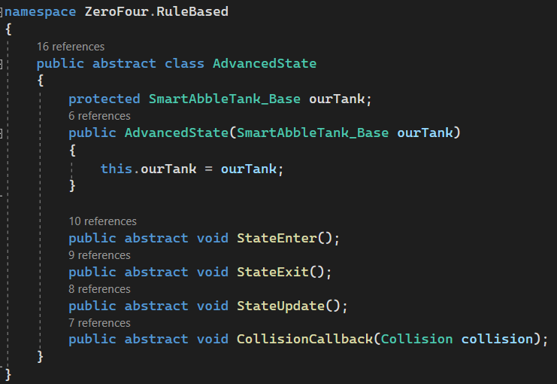
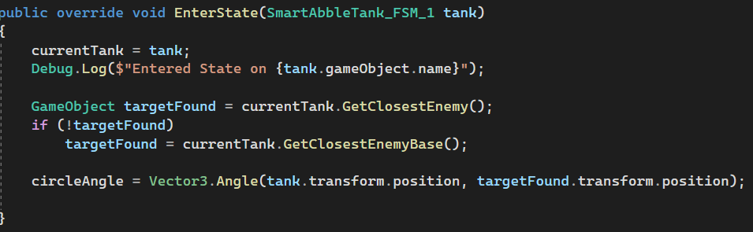

Making The States
Our states all inherit from a class we called AdvancedState
This class contains the various methods our states use including:
EnterState()
ExitState() UpdateState()
Each of these methods can be overridden by all states that inherit AdvancedState, allowing us to code state-specific behaviors to the same method.
Screenshot from AdvancedState Script
Screenshot of the EnterState() method being overridden on the AttackState script
What is a Rule Based System?
A Rule Based System is a system that relies on various facts called Predicates to make decisions.
Predicates represent Boolean Truths (True/False)
We can use these Predicates to construct Rules, and the outcome of the decision will rely on whether rules are met. Rule based systems are known as a Goal Driven Architecture for AI, meaning the AI has a final goal (such as destroying the enemy tank.)

Slide 27
Making The States
Our states all inherit from a class we called AdvancedState
This class contains the various methods our states use including:
EnterState()
ExitState() UpdateState()
Each of these methods can be overridden by all states that inherit AdvancedState, allowing us to code state-specific behaviors to the same method.
Screenshot from AdvancedState Script
Screenshot of the EnterState() method being overridden on the AttackState script
What is a Rule Based System?
A Rule Based System is a system that relies on various facts called Predicates to make decisions.
Predicates represent Boolean Truths (True/False)
We can use these Predicates to construct Rules, and the outcome of the decision will rely on whether rules are met. Rule based systems are known as a Goal Driven Architecture for AI, meaning the AI has a final goal (such as destroying the enemy tank.)

Slide 28
Making The States
Our states all inherit from a class we called AdvancedState
This class contains the various methods our states use including:
EnterState()
ExitState() UpdateState()
Each of these methods can be overridden by all states that inherit AdvancedState, allowing us to code state-specific behaviors to the same method.
Screenshot from AdvancedState Script
Screenshot of the EnterState() method being overridden on the AttackState script
What is a Rule Based System?
A Rule Based System is a system that relies on various facts called Predicates to make decisions.
Predicates represent Boolean Truths (True/False)
We can use these Predicates to construct Rules, and the outcome of the decision will rely on whether rules are met. Rule based systems are known as a Goal Driven Architecture for AI, meaning the AI has a final goal (such as destroying the enemy tank.)

Slide 29
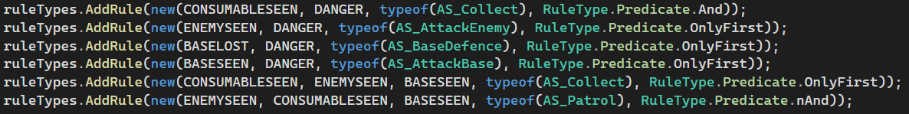



Making The States
The Rules
Our states all inherit from a class we called AdvancedState
This class contains the various methods our states use including:
EnterState()
ExitState() UpdateState()
Each of these methods can be overridden by all states that inherit AdvancedState, allowing us to code state-specific behaviors to the same method.
For our Rule Based System to work, our tank needs a set of rules to follow.
We have written a function to add rules that takes facts, the state that the rule will switch to, and the Boolean operator that the rule makes use of
Below is a code screenshot of our rules:
Screenshot from AdvancedState Script
Screenshot of the EnterState() method being overridden on the AttackState script

Slide 30
Making The States
The Rules
Our states all inherit from a class we called AdvancedState
This class contains the various methods our states use including:
EnterState()
ExitState() UpdateState()
Each of these methods can be overridden by all states that inherit AdvancedState, allowing us to code state-specific behaviors to the same method.
For our Rule Based System to work, our tank needs a set of rules to follow.
We have written a function to add rules that takes facts, the state that the rule will switch to, and the Boolean operator that the rule makes use of
Below is a code screenshot of our rules:
Screenshot from AdvancedState Script
Screenshot of the EnterState() method being overridden on the AttackState script

Slide 31
The End
Any questions?

